Slide 1



A Comparative Study of Stress Levels and Learning Experiences in Trimester and Semester Systems
Case Study on Academic Stress Level
Dhillipkumar.M
2348026

Slide 2

Abstract
This study explores the experiences of first-year and senior students in different academic systems — the trimester and traditional semester. By surveying stress levels, workload perceptions, and overall well-being, we uncover significant differences in stress levels, highlighting the unique challenges of the trimester pattern. Importantly, our findings show that the trimester system significantly impacts the overall learning experience. Insights from seniors provide valuable context. The study suggests recommendations for better support, peer interaction, and holistic student well-being. This work contributes to understanding student experiences and guides improvements for a more supportive academic environment.

Slide 3
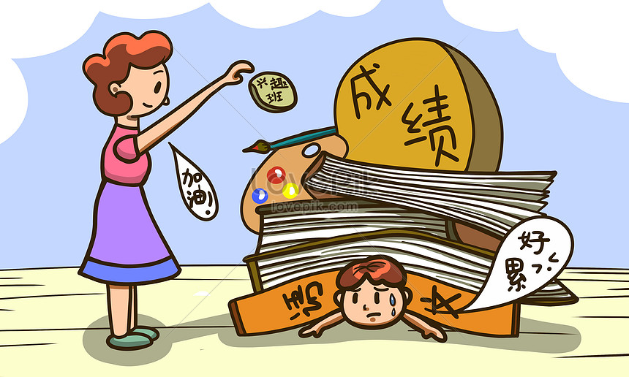
Introduction
Objective:
The primary objective of this survey is to explore and compare the academic stress levels, learning experiences, and well-being of first-year (Junior) and senior students under different academic systems.
Importance:
Understanding the impact of academic systems on students' stress levels and experiences is crucial for creating supportive learning environments. This study sheds light on the challenges faced by students and provides valuable insights for improving academic systems.
Focus on Comparison:
Our focus lies in comparing two distinct groups — the first-year students who are navigating the trimester pattern and the senior students who experienced the traditional semester system.
Throughout this presentation, we will delve into survey questions, hypothesis tests, and statistical results to uncover meaningful patterns and draw valuable conclusions.

Slide 4
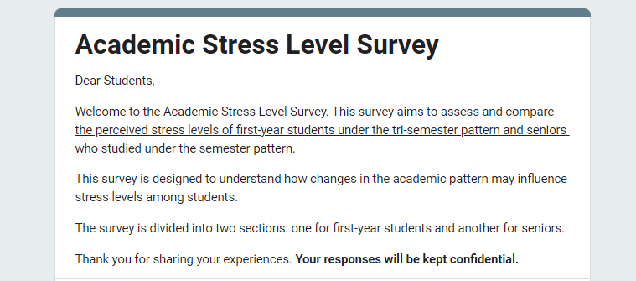
Case Study Survey Questions
https://docs.google.com/forms/d/e/1FAIpQLSf_TSac1Wj3z8qrcamTYVEmGY_KoqA671iQehgHL0D2nD8msA/viewform?usp=sf_link

Slide 5
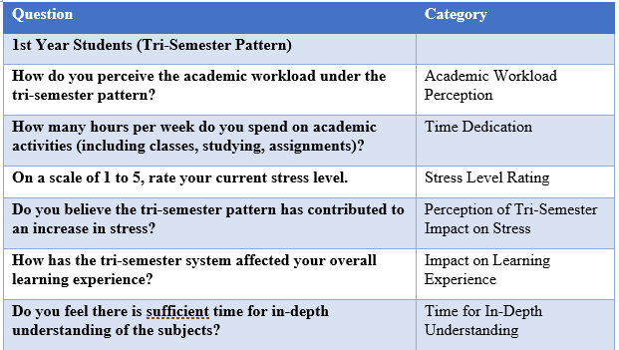
1st year MDS Students Questions
"Exploring the Trimester Journey: Perspectives from Junior Participants"

Slide 6
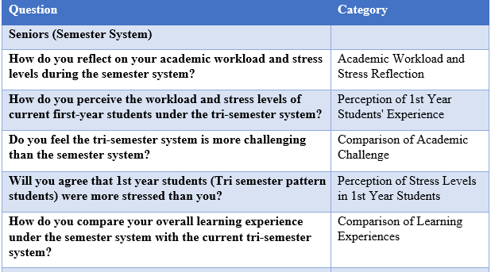
2nd year MDS Students Questions
"Exploring the Semester Journey: Perspectives from Senior Participants"

Slide 7
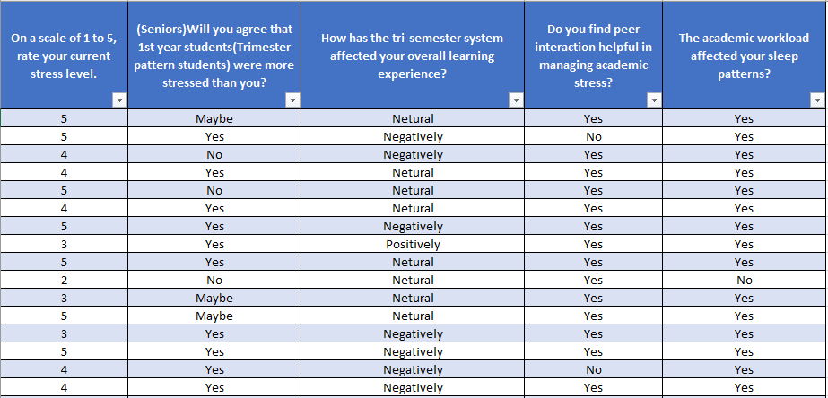
Responses:

Slide 8
Variables of Interest
On a Scale of 1 to 5, Rate Your Current Stress Level:
Juniors (First-Year Students): This question aims to quantify the self-perceived stress levels of first-year students on a scale from 1 (low stress) to 5 (high stress). It provides a numerical measure of the subjective stress experience.
Seniors: Similar to juniors, senior students are asked to rate their current stress levels on the same scale. This allows for a direct comparison between the stress levels of first-year and senior students.
How Has the Trimester System Affected Your Overall Learning Experience?
Juniors: This open-ended question invites students to reflect on the impact of the trimester system on their overall learning experience. It allows for qualitative insights into the perceived advantages or challenges of the academic structure.
Do You Find Peer Interaction Helpful in Managing Academic Stress?
Juniors : This question explores the role of peer interaction in coping with academic stress. It assesses whether students believe that interacting with peers has a positive influence on managing the challenges posed by academic stress.
The Academic Workload Affected Your Sleep Patterns?
Juniors : This question investigates the potential impact of academic workload on sleep patterns among students. It aims to understand whether academic demands have noticeable effects on the sleep quality and patterns of seniors.

Slide 9
Hypothesis Testing
1. Comparison of Stress Levels between First-Year and Senior Students:
Objective:
To examine whether there is a significant difference in the average stress levels between first-year and senior students within the MSc Data Science program, providing insights into the potential impact of academic structures on stress perception.
2. Comparison of Overall Learning Experience
Objective:
To investigate the impact of the trimester system on the overall learning experience of students in the MSc Data Science program, whether the trimester system has a statistically significant positive impact on the overall learning experience of students or not.

Slide 10
Hypothesis Testing
3. Evaluation of Peer Interaction:
Objective:
To assess the association between peer interaction and academic stress management among students, This objective aims to understand the significance of peer interaction in coping with academic stress.
4. Comparison of Overall Learning Experience
Objective:
To determine whether there is a statistically significant proportion of first-year students reporting that academic workload affects their sleep patterns. This objective seeks to explore the potential impact of academic demands on the sleep quality of students in the trimester system

Slide 11
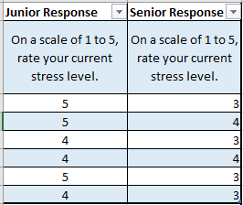
1. Comparison of Stress Levels between First-Year and Senior Students:
Questions considered for the testing:
First year students question:
On a scale of 1 to 5, rate your current stress level.
Seniors question:
On a scale of 1 to 5, rate your current stress level.
Sample Size:
The junior sample consists of 29 responses.
The senior sample consists of 24 responses.

Slide 12
Objective:
The objective of this hypothesis test is to explore whether there is a significant difference in stress levels between first-year (junior) and senior students within the MSc Data Science program.
Type of Test: Independent Two-Sample t-Test
Why this test:
The independent two-sample t-test is chosen for this analysis because it is suitable for comparing the means of two independent groups and sample size is less than 30. In our case, we are comparing the average stress levels between two distinct groups: first-year (junior) students under the trimester system and senior students who experienced the traditional semester system.
Significance Level (α): 0.05
Here the null and alternative hypothesis is
1. Null Hypothesis (H0):
There is no significant difference in the average stress levels between first-year and senior students.
2. Alternative Hypothesis (H1):
The average stress level of first-year students is greater than senior students.(Right tailed Test)

Slide 13
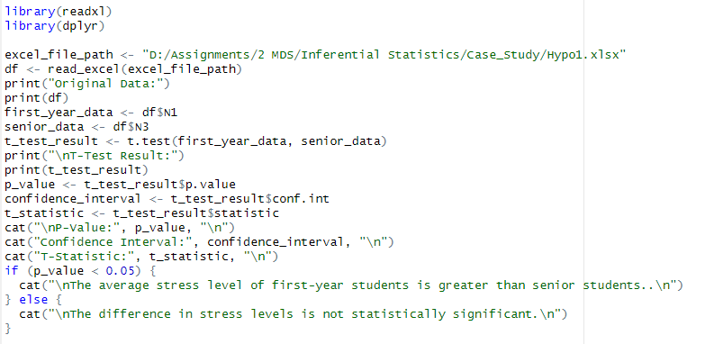
Code:

Slide 14
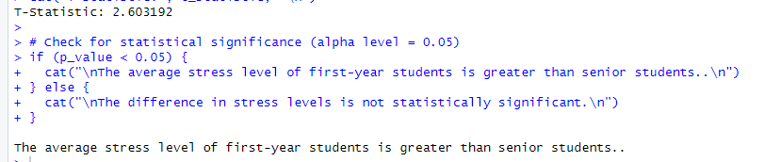
Result:
Inference:
Since the p-value is 0.012, which is less than the significance level of 0.05, we reject the null hypothesis. Therefore, we have sufficient evidence to conclude that the average stress level of first-year students is greater than senior students.

Slide 15
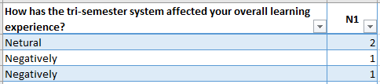
2.Comparison of Overall Learning Experience:
Question considered for the testing:
First year students question:
How has the trimester system affected your overall learning experience?
Sample Size:
The junior sample consists of 29 responses.

Slide 16
Objective:
The objective of this hypothesis test is to investigate whether the trimester system has a statistically significant positive impact on the overall learning experience of students or not.
Type of Test: One-Sample t-Test
Why this test:
The one-sample t-test is chosen for this analysis because it allows us to determine if the mean of a single sample significantly differs from a known or hypothesized population mean and sample size is less than 30. In this case, we are comparing the mean perception of the overall learning experience under the trimester system to a positive position (Positive Impact), as represented by the null hypothesis.
Significance Level (α): 0.05
Here the null and alternative hypothesis is
1. Null Hypothesis (H0):
The overall learning experience under the trimester system to a positive position (Positive Impact).
2. Alternative Hypothesis (H1):
The overall learning experience under the trimester system is not giving a positive impact.(Two Tailed Test)

Slide 17
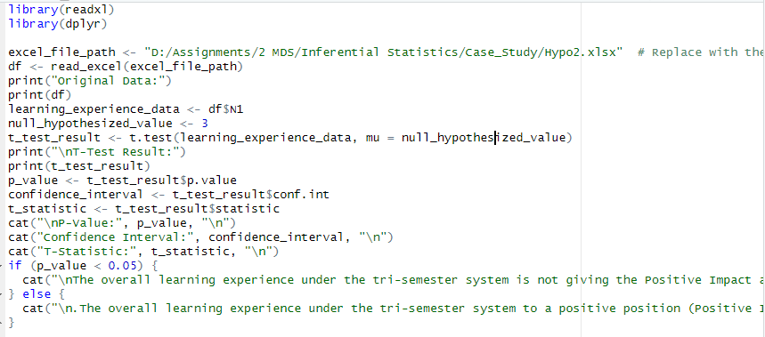
Code:

Slide 18
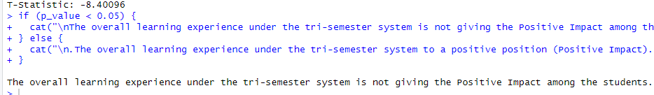
Result:
Inference:
Since the p-value is 0.000000003880359, which is less than the significance level of 0.05, we reject the null hypothesis. Therefore, we have sufficient evidence to conclude that the overall learning experience under the trimester system is not giving a positive impact.

Slide 19
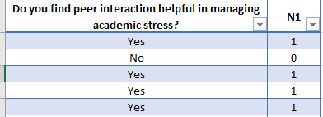
3. Evaluation of Peer Interaction:
Question considered for the testing:
First year students question:
Do you find peer interaction helpful in managing academic stress?
Sample Size:
The junior sample consists of 29 responses.

Slide 20
Objective:
The objective of this hypothesis test is to explore whether there is a significant association between peer interaction and academic stress management among MSc Data Science students.
Type of Test: Chi-Squared Test for Independence
Why this test:
The Chi-Squared Test for Independence is selected for this analysis because it is suitable for examining whether there is a significant association between peer interaction and academic stress management among MSc Data Science students.
Significance Level (α): 0.05
Here the null and alternative hypothesis is
1. Null Hypothesis (H0):
There is no association between peer interaction and academic stress management.
2. Alternative Hypothesis (H1):
There is a association between peer interaction and academic stress management (Two tailed test).

Slide 21
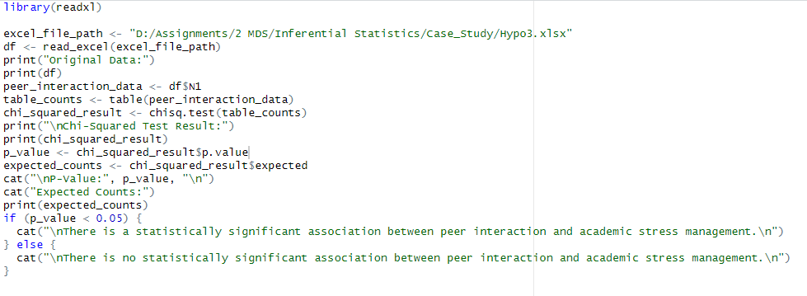
Code:

Slide 22
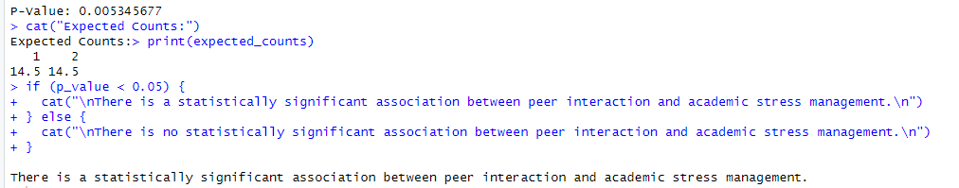
Result:
Inference:
Since the p-value is 0.005345677, which is less than the significance level of 0.05, we reject the null hypothesis. Therefore, we have sufficient evidence to conclude that there is a significant association between peer interaction and academic stress management.

Slide 23
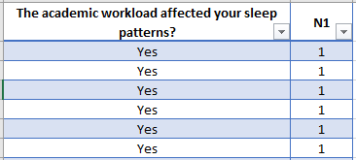
4. Sleep Patterns and Academic Workload:
Question considered for the testing:
First year students question:
The academic workload affected your sleep patterns?
Sample Size:
The junior sample consists of 29 responses.

Slide 24
Objective:
The objective of this hypothesis test is to determine whether there is evidence that the academic workload significantly affects the sleep patterns of first-year students in the MSc Data Science program.
Type of Test: One-Sample Proportion Test
Why this test:
The One-Sample Proportion Test is selected for this analysis because it is designed to examine whether the proportion of successes in a single sample is significantly different from a known or hypothesized population proportion. In this case, we are investigating whether the reported impact of academic workload on sleep patterns among first-year students deviates significantly from the hypothesized proportion.
Significance Level (α): 0.05
Here the null and alternative hypothesis is
1. Null Hypothesis (H0):
The proportion of 1st-year students reporting that academic workload affects sleep patterns is less than
or equal to 0.5.
2. Alternative Hypothesis (H1):
The proportion of 1st-year students reporting that academic workload affects sleep patterns is greater
than 0.5 (Right tailed test).

Slide 25
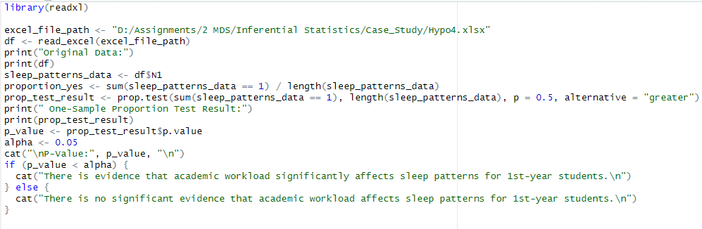
Code:

Slide 26
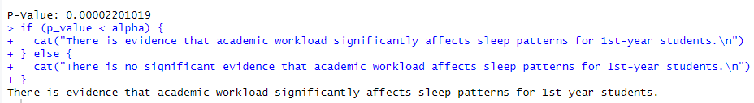
Result:
Inference:
Since the p-value is 0.000022, which is less than the significance level of 0.05, we reject the null hypothesis. Therefore, we have sufficient evidence to conclude that students were reporting that academic workload affects sleep patterns.

Slide 27
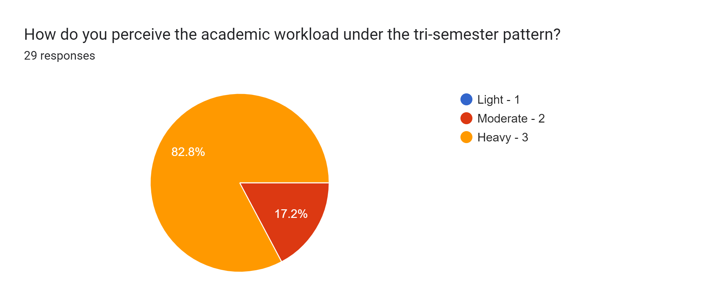
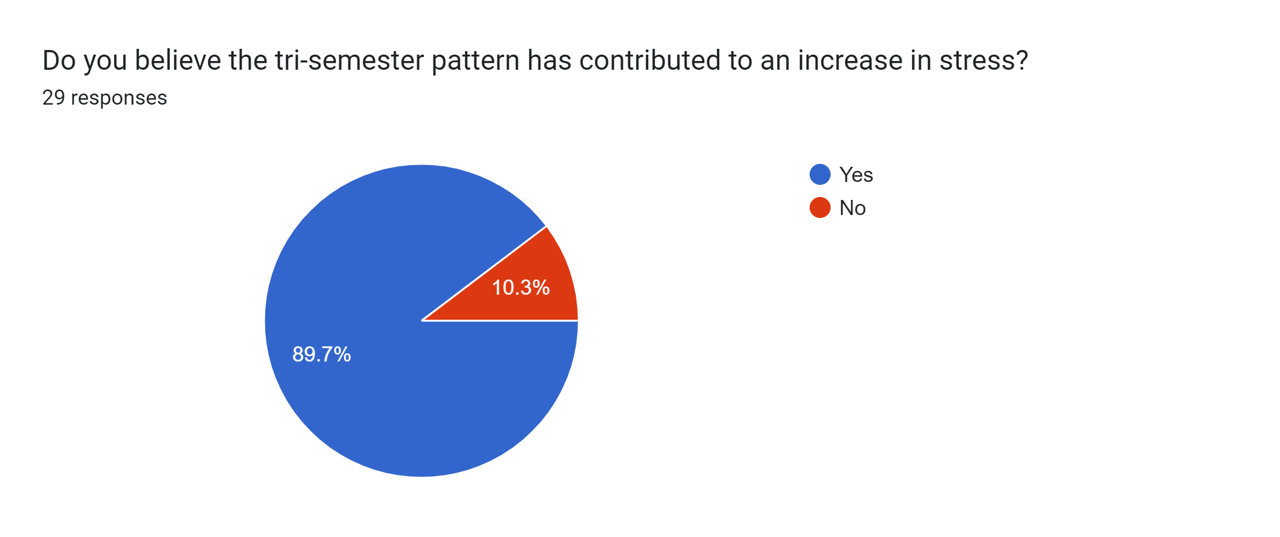
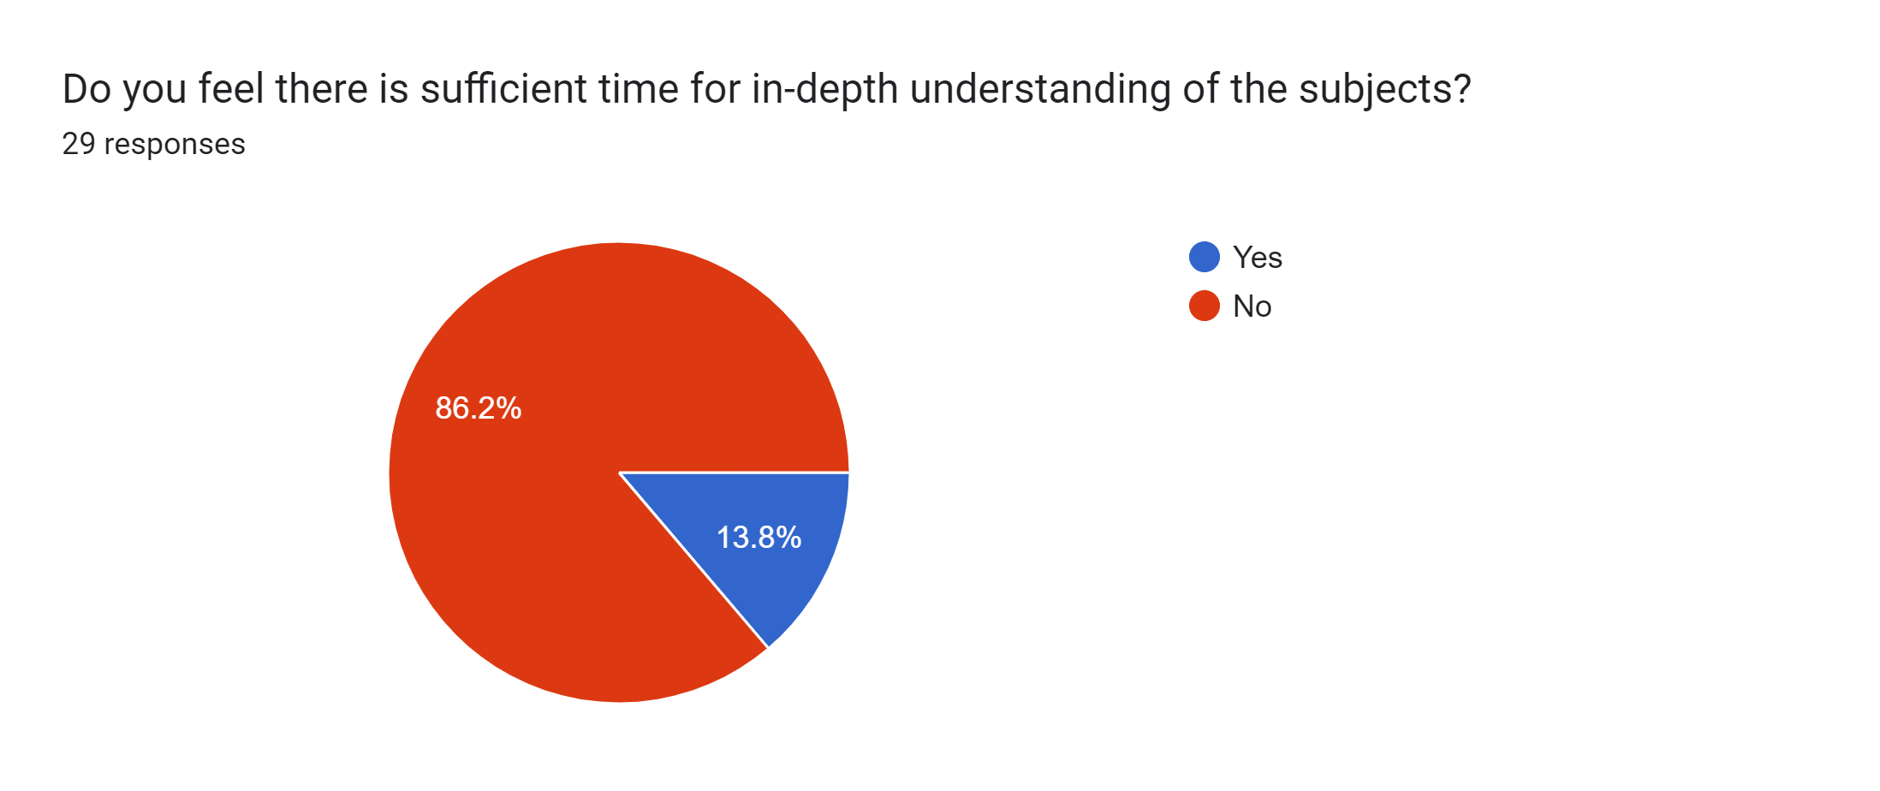
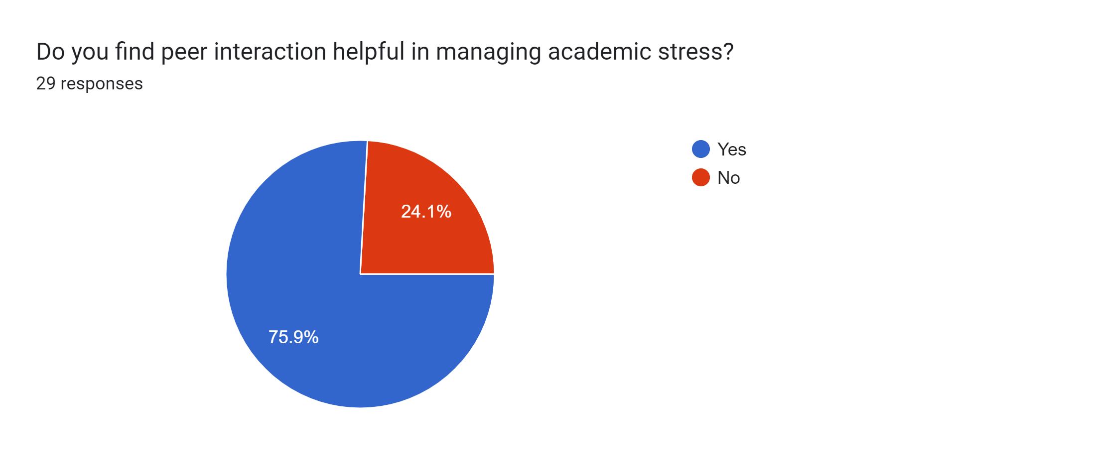
Pictorial representations of the 1st year students responses:

Slide 28
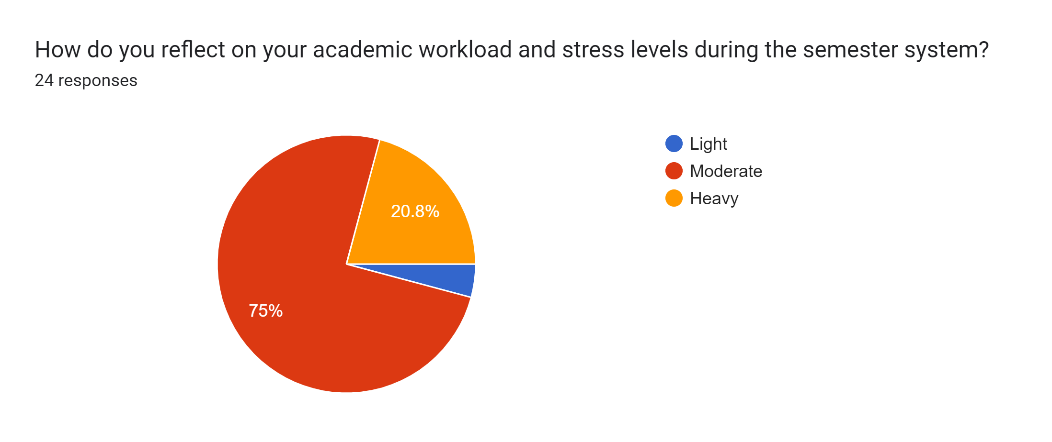
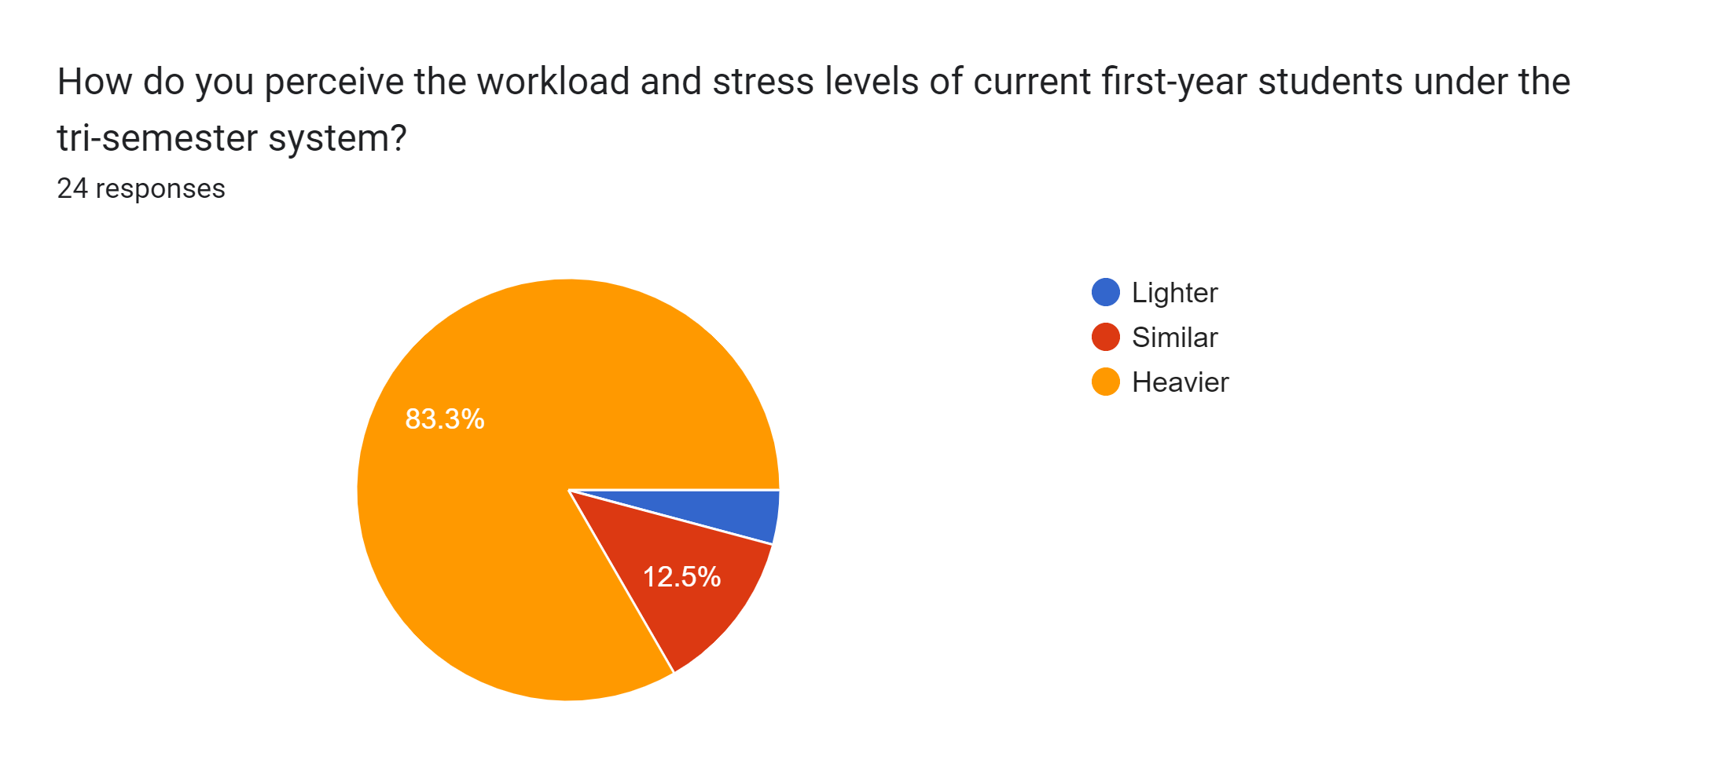
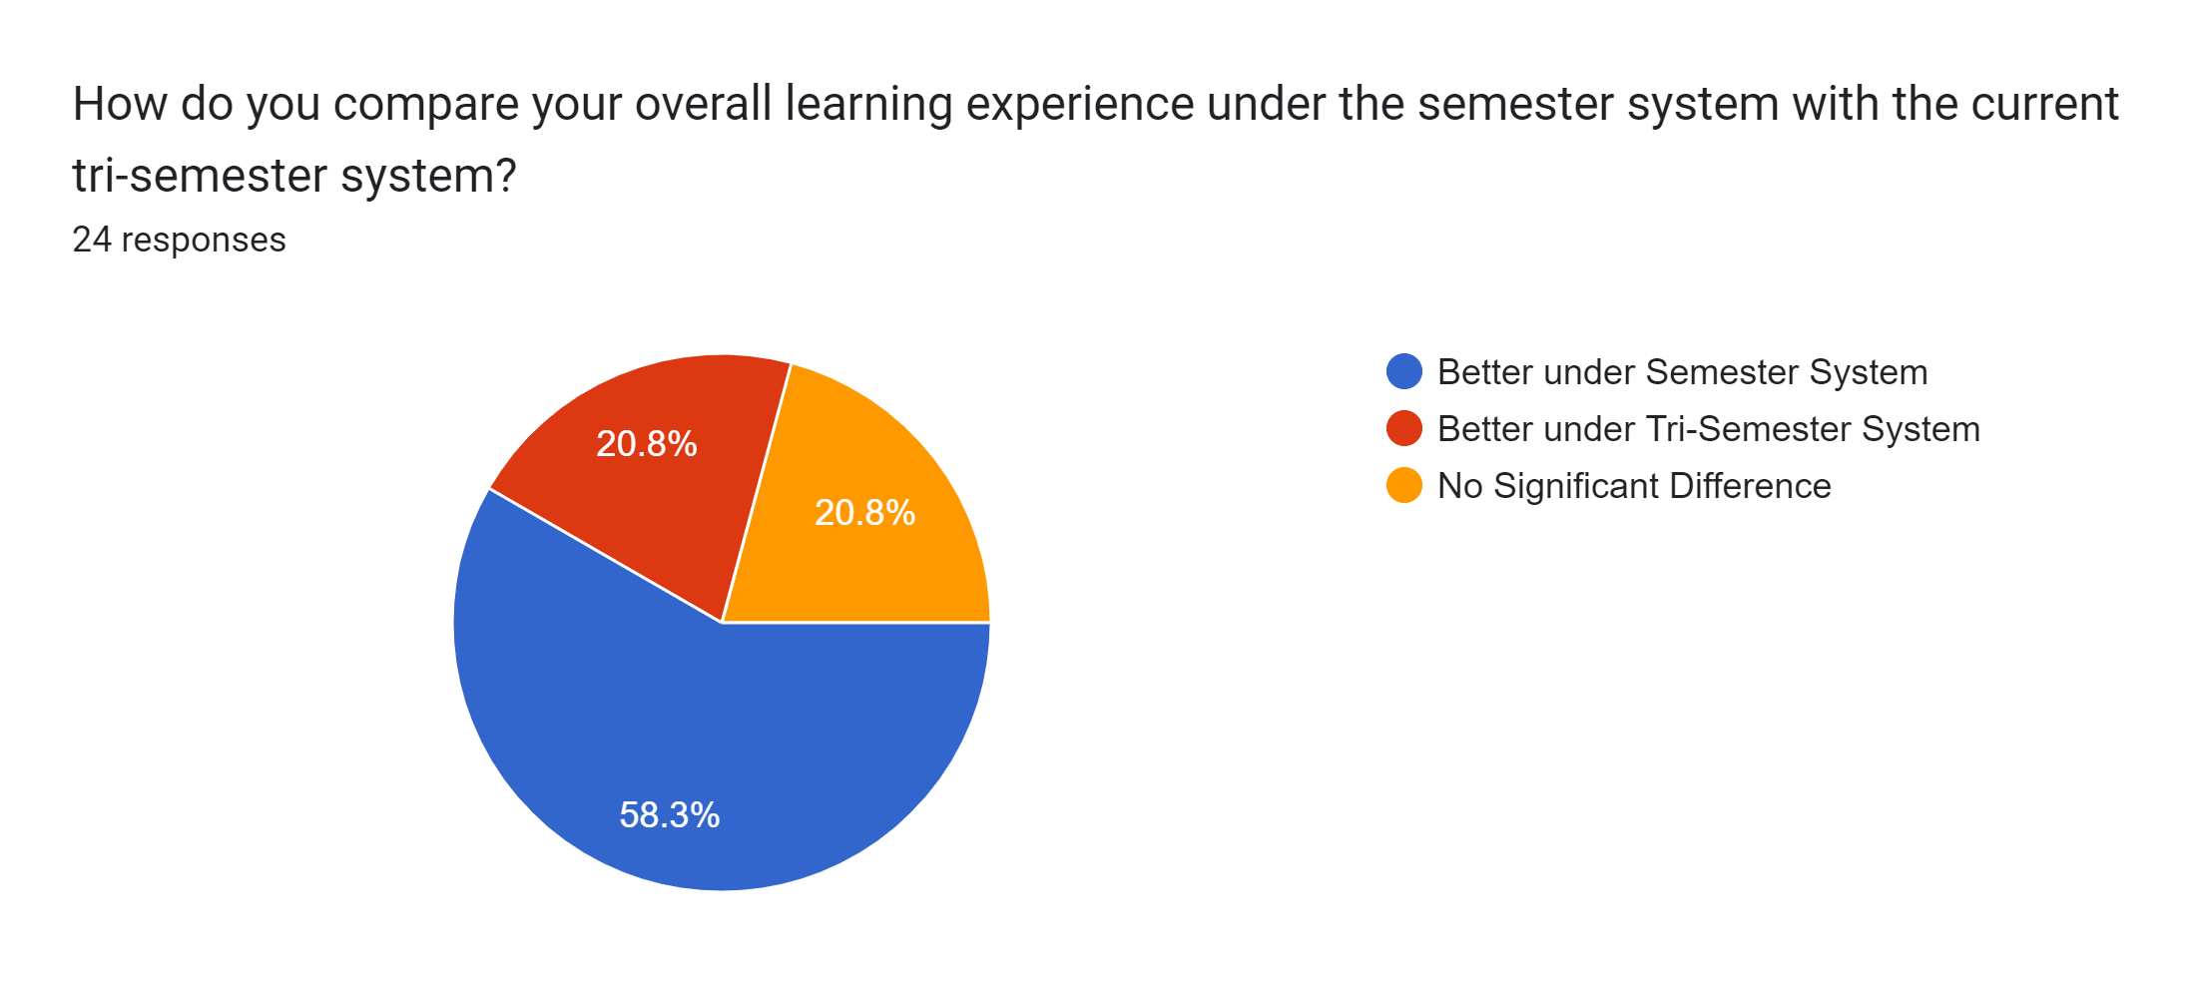
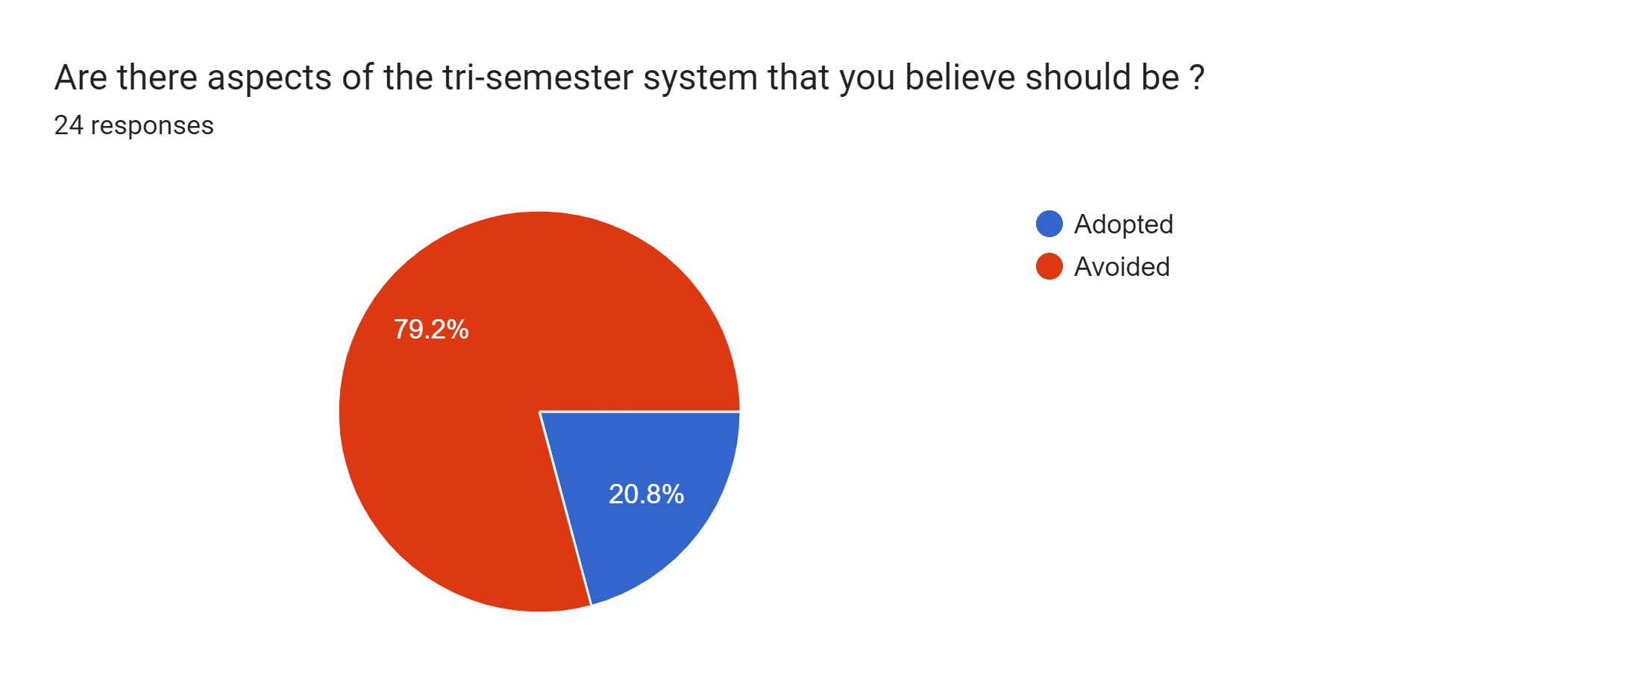
Pictorial representations of the 2nd year students responses:

Slide 29

Inference
Our extensive academic stress level survey yielded significant insights. Notably, a statistically significant
difference in stress levels was observed between first-year and senior students under the trimester
system, highlighting the unique challenges of this condensed academic structure. This underscores the
transformative impact of the trimester system on the overall learning experience, as confirmed by our
findings.
The survey also emphasized the crucial role of peer interaction in managing academic stress, emphasizing
the necessity for ongoing efforts to cultivate a supportive student community. Additionally, sleep patterns
were identified as significantly affected by the academic workload, emphasizing the importance of a holistic
approach to student well-being.
Reflections from senior students provided valuable comparisons with the traditional semester system,
offering a context-rich understanding of the evolving academic landscape.

Slide 30

Recommendation
Navigating the evolving academic landscape prompts several key recommendations based on our survey
findings. Firstly, adapting support systems to the specific challenges of the trimester pattern is crucial,
including workshops on time management and stress reduction. Second, fostering enhanced peer interaction
through structured initiatives is vital for building a supportive community. Improving feedback mechanisms
and seamlessly integrating extracurricular activities into the schedule can further enhance the student
experience. Additionally, raising awareness about sleep hygiene amid academic pressures is vital for student
health.

Slide 31

Conclusion
In concluding our exploration of academic experiences among first-year and senior students, a nuanced
understanding emerges. The comparison of stress levels between these groups reveals a statistically
significant difference, emphasizing the unique challenges of the trimester pattern. Our findings affirm
that the trimester system has a significant impact on the overall learning experience, highlighting its
transformative nature. The importance of peer interaction in managing academic stress is underscored,
emphasizing the need for supportive connections within our academic community. Additionally, the survey
identifies a significant impact on the sleep patterns of first-year students due to academic workload.
Insights from senior perspectives provide valuable comparisons and reflections on challenges faced under
the semester system. As we navigate the dynamic academic landscape, these findings form a foundation for
future discussions and improvements in our educational environment.

Slide 32

Future Prospects of the Study:
Adaptive Support Systems:
Tailoring support systems to address the unique challenges of the trimester pattern is imperative. Future initiatives should include targeted workshops on time management and stress reduction, aiding students in navigating the condensed academic structure effectively.
Fostering Peer Interaction:
Recognizing the pivotal role of peer interaction in managing academic stress, future endeavors should focus on fostering enhanced peer connections through structured initiatives. Building a supportive community contributes significantly to the overall well-being of students.

